Slide 1
Unit 4
Lecture 3

Slide 2
Some basic compression methods:
Huffman coding
Golomb coding
Arithmetic coding
Lempel-Ziv-Welch (LZW) coding
Run Length coding
Symbol based coding
Bit plane coding
Block transform coding
Predictive coding
Wavelet coding

Slide 3
Arithmetic coding
Method of generating variable length code
Useful when dealing source with small alphabets
Uses a unique identifier called Tag
Tag value always lies between [0,1]
Lower limit l=0 and upper limit is u=1

Slide 4
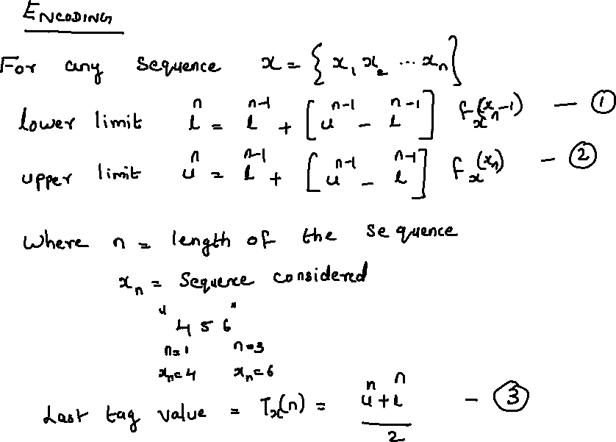

Slide 5
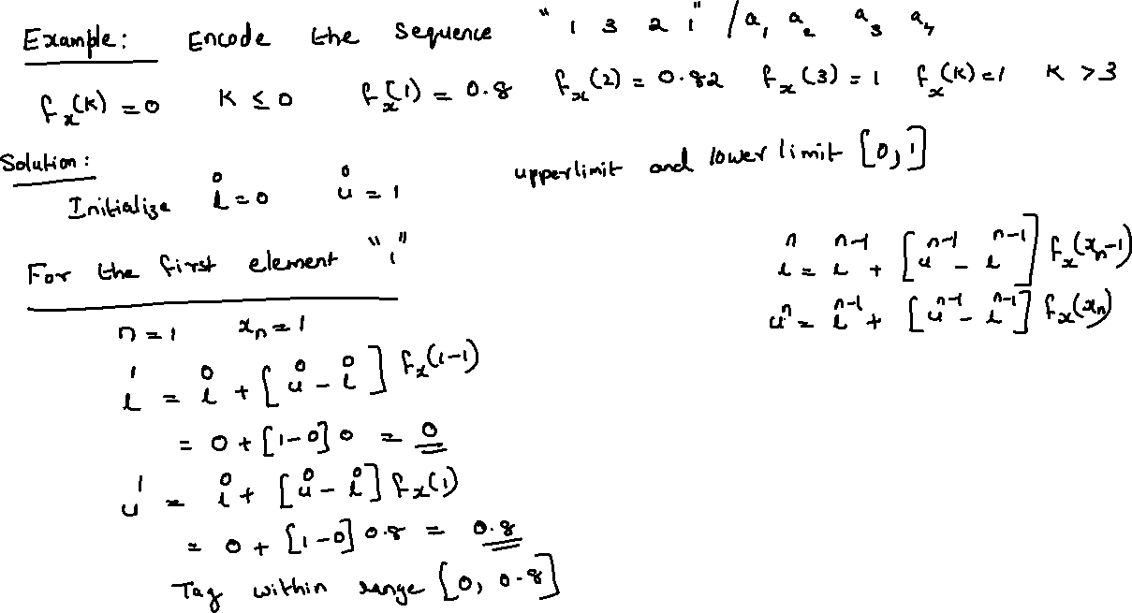

Slide 6
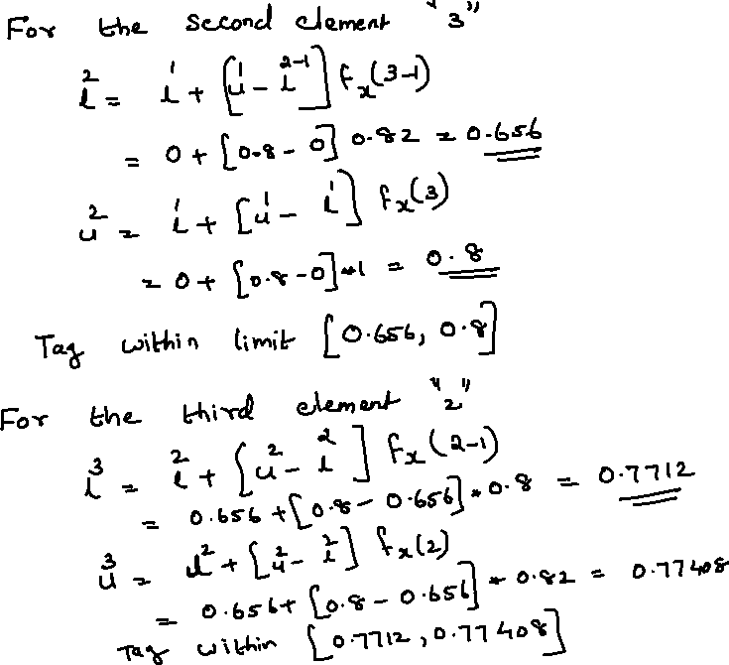

Slide 7
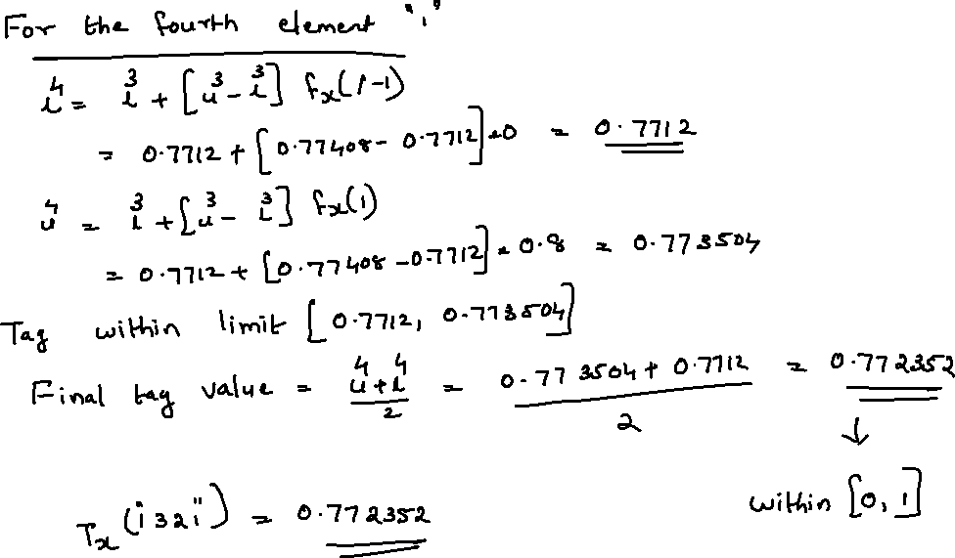

Slide 8
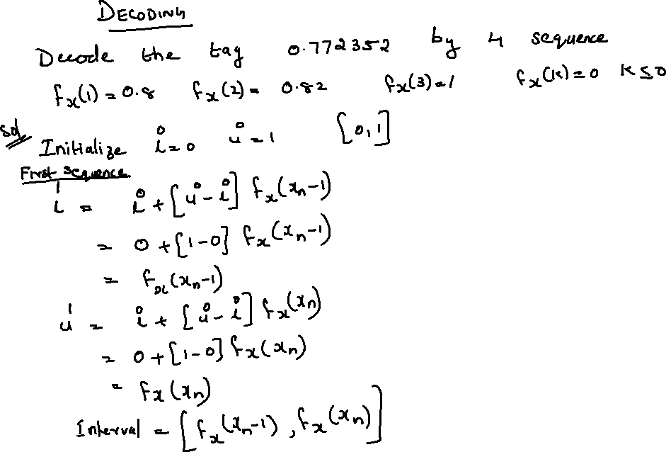

Slide 9
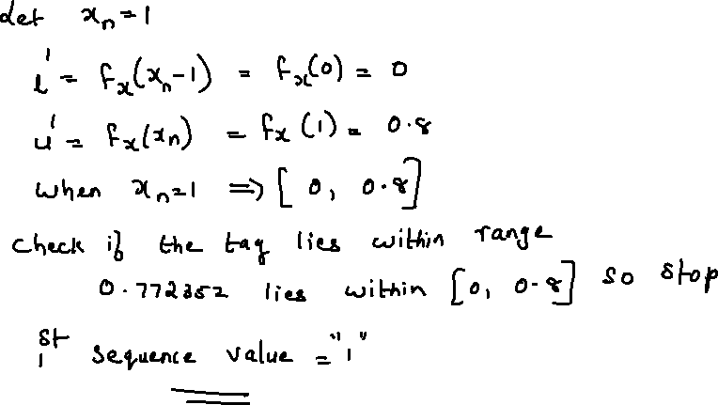

Slide 10
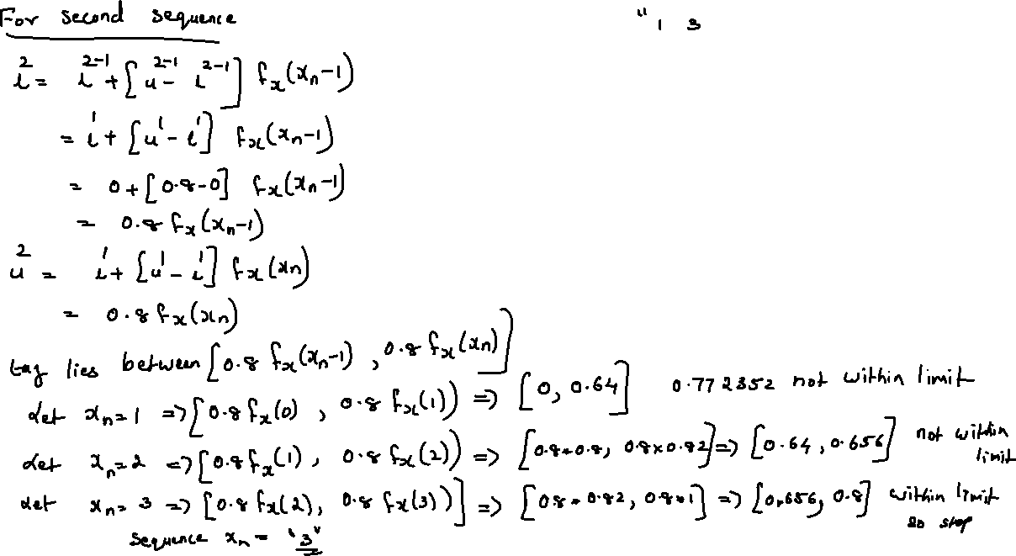

Slide 11
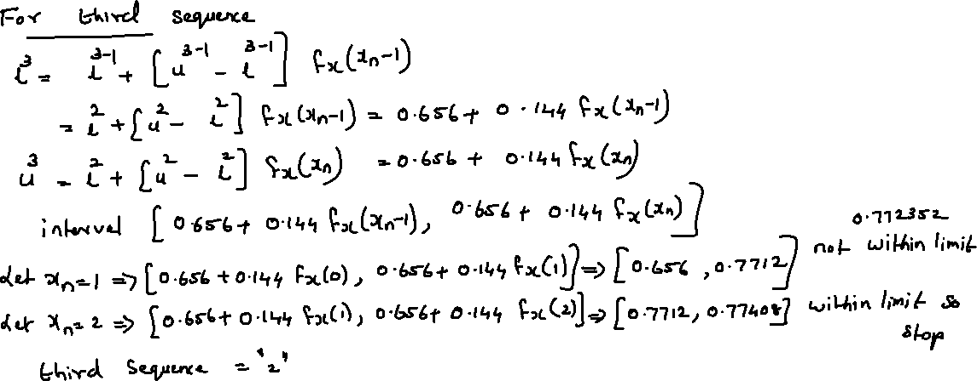

Slide 12
